Slide 1
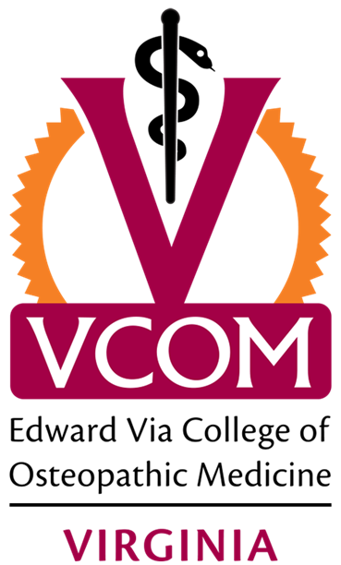
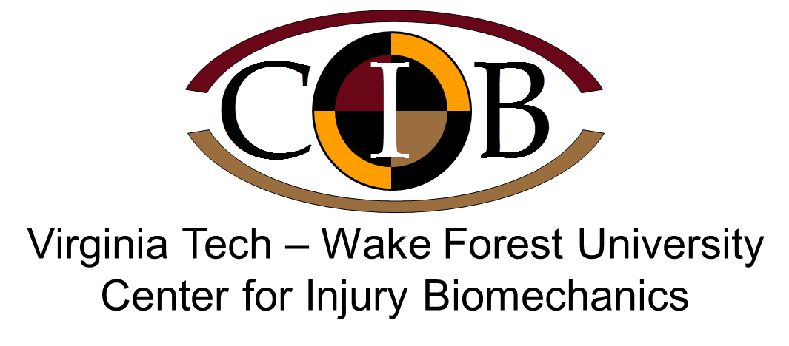
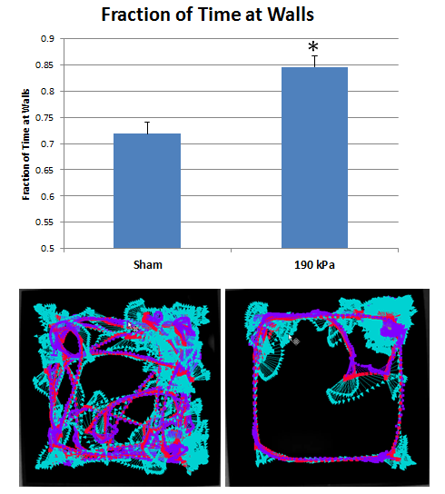
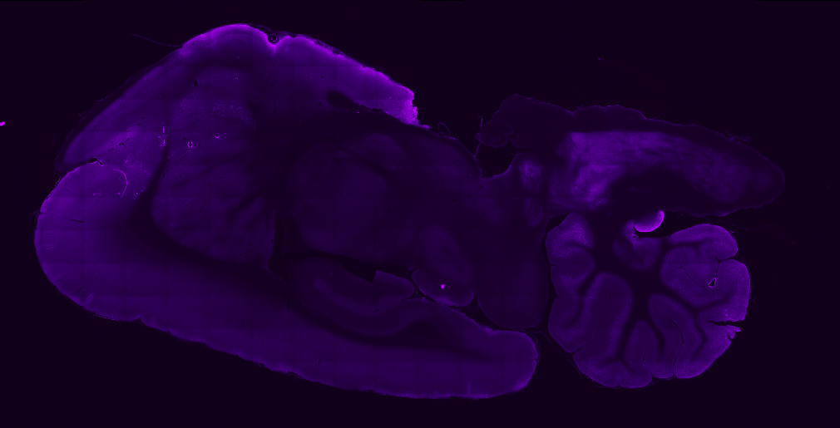
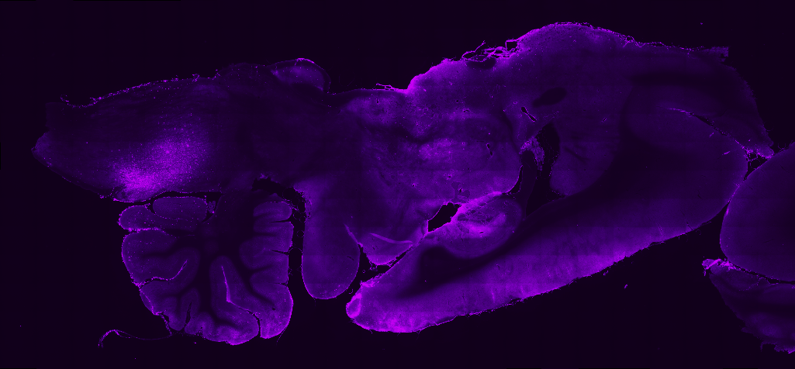
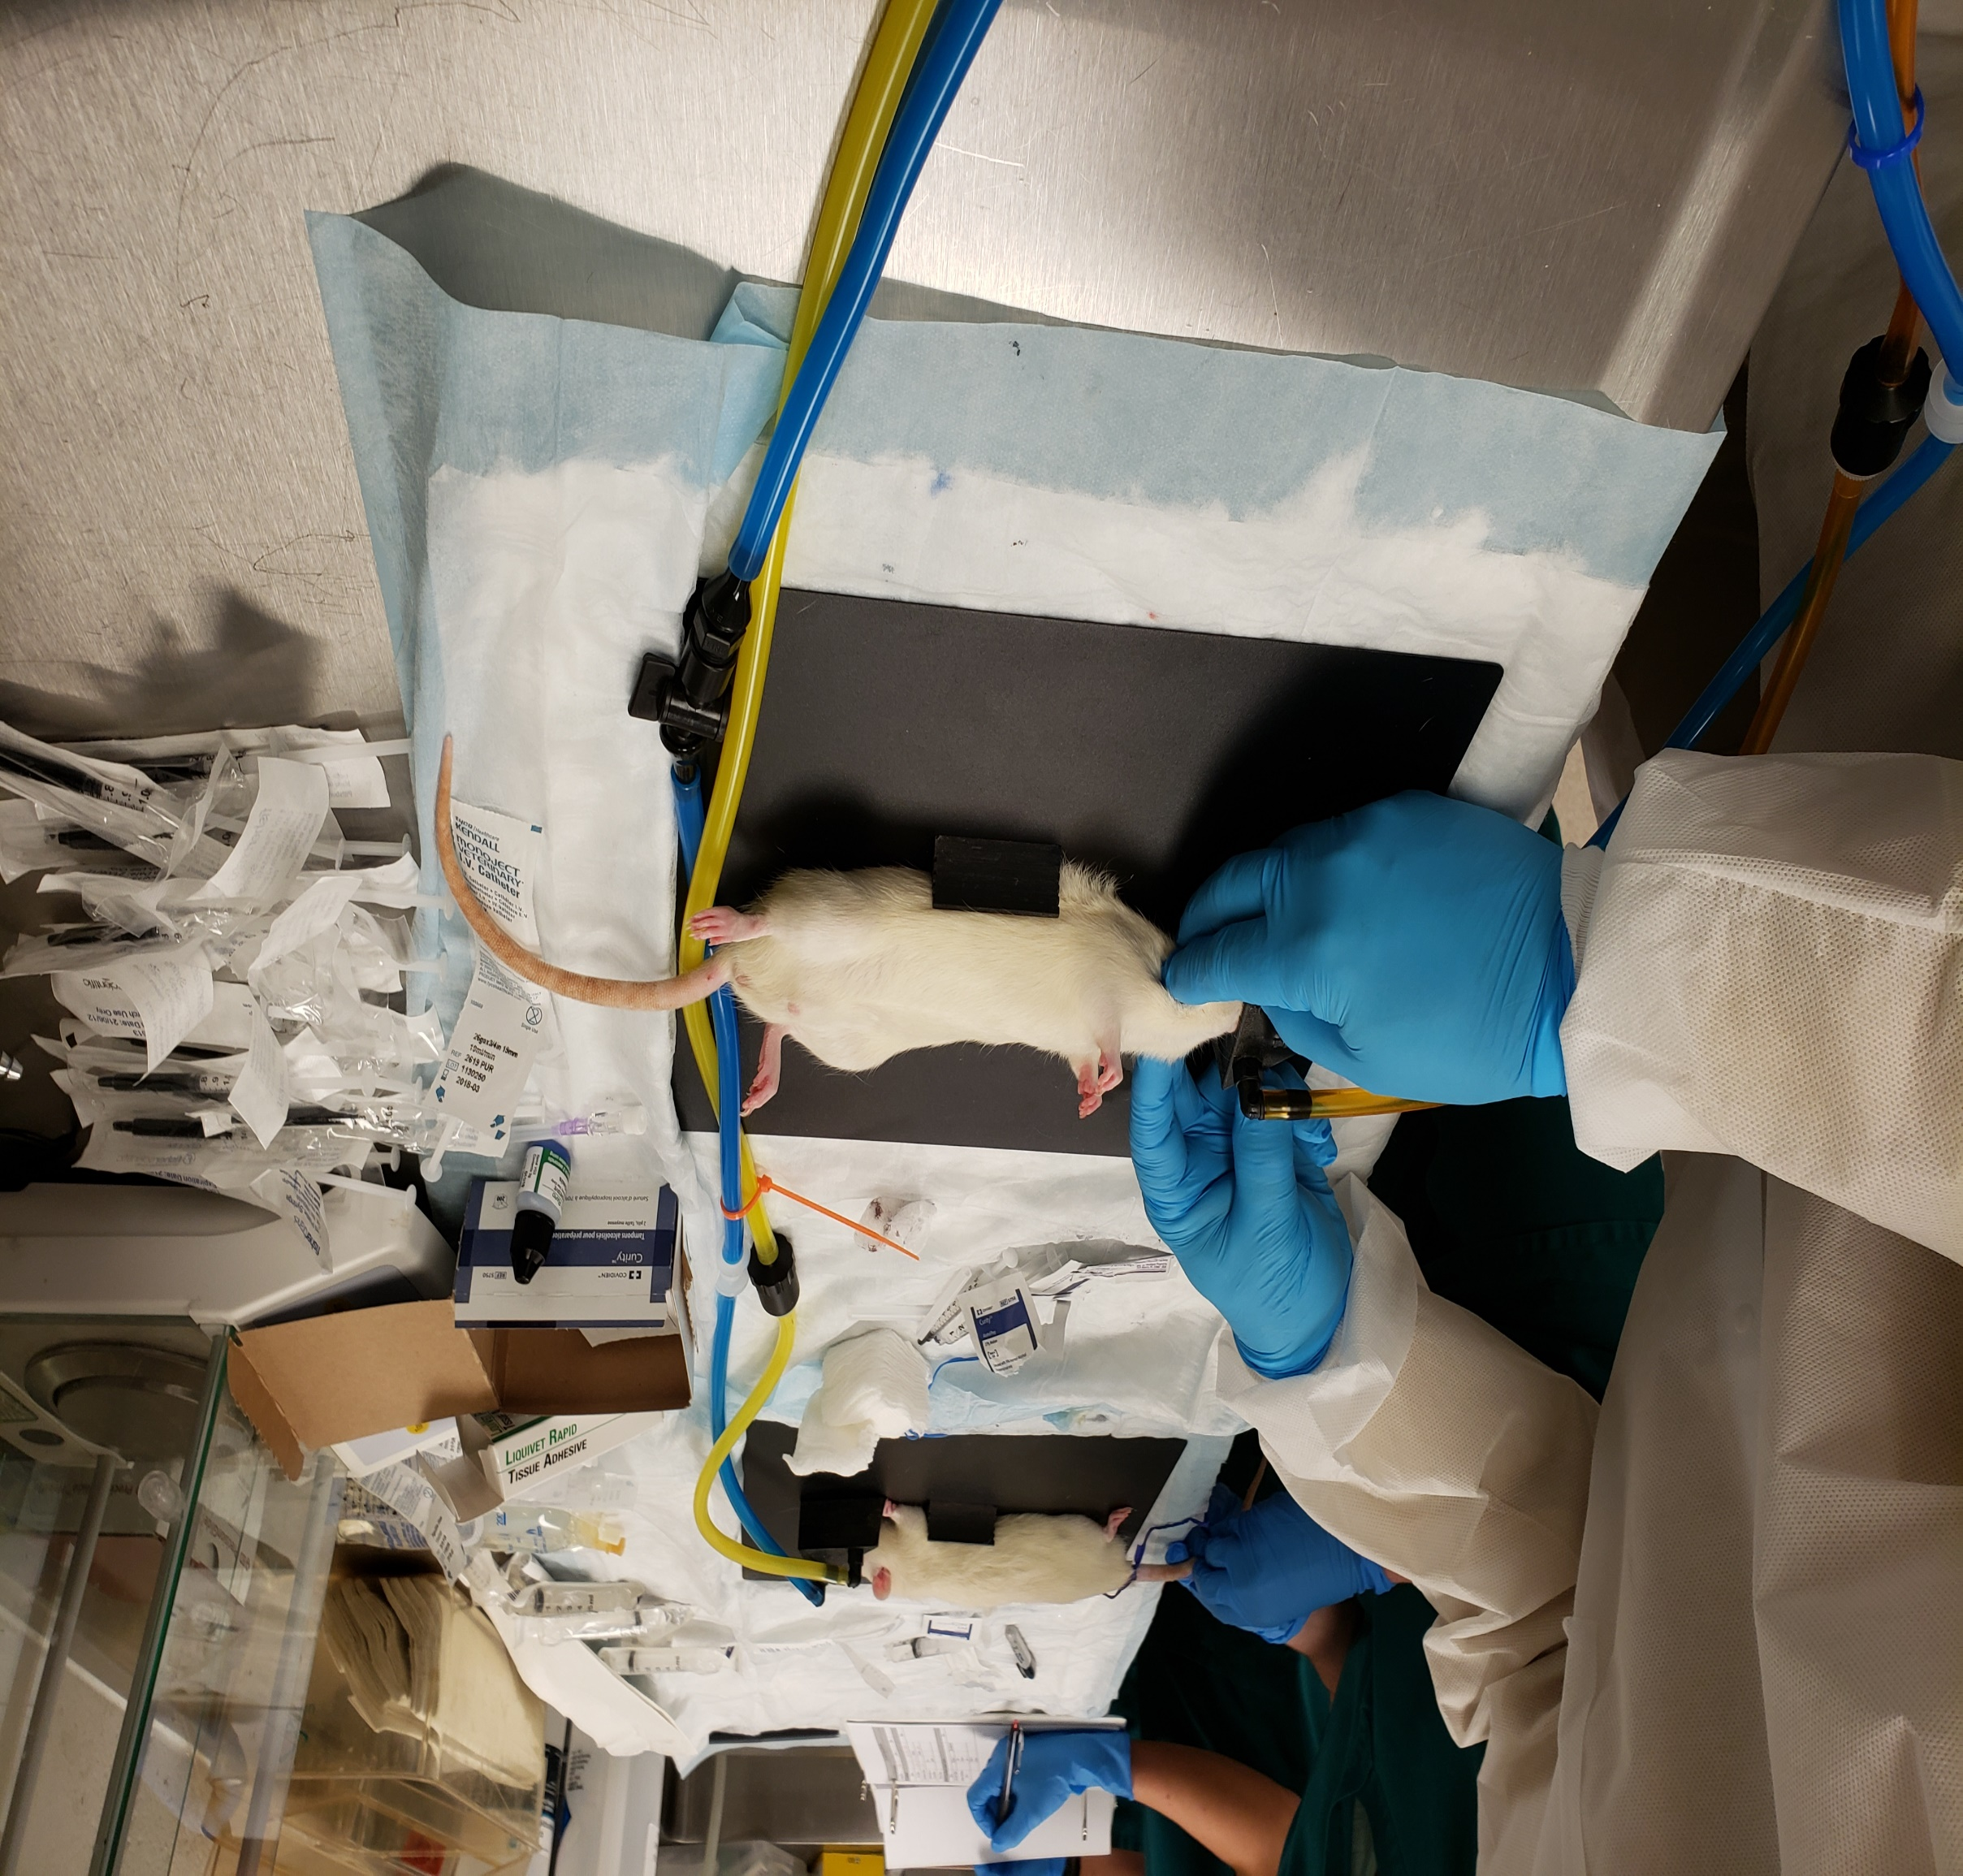
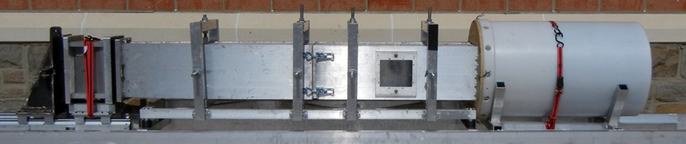
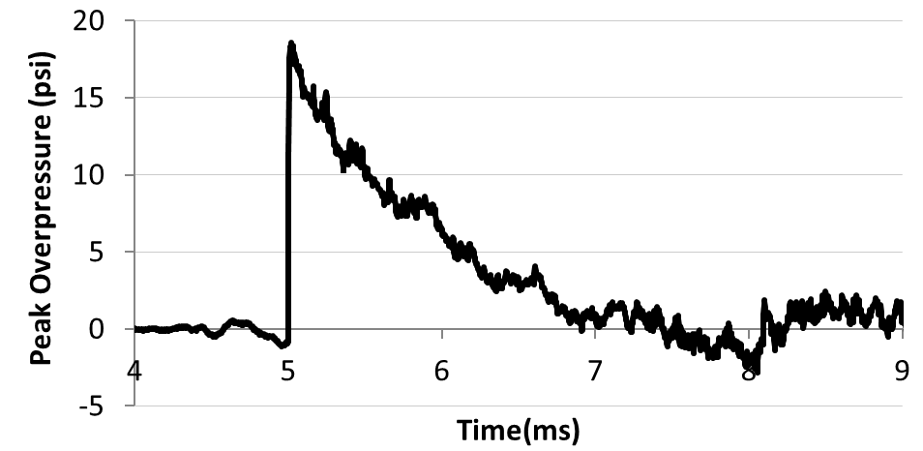
Osteopathy in the cranial field as a method to enhance brain injury recovery: A preliminary study
Susan Murphy² PhD, Michelle Dickerson² BSc, Caiti-Erin Talty² BSc, Gunnar Brolinson¹ DO, and Pamela VandeVord² PhD.
¹Edward Via College of Osteopathic Medicine, Blacksburg, VA 24061
²Biomedical Engineering and Mechanics, Virginia Tech, Blacksburg, VA 24061
Contact Information for Questions and Further Discussion: Gunnar Brolinson, pbrolins@vcom.edu; Pamela VandeVord, pvord@vt.edu
INTRODUCTION
RESULTS
A
B
A
Traumatic brain injury (TBI) represents a significant clinical burden. In the United States, around 1.7 million people suffer TBI. Around 80% of all TBI cases are categorized as mild head injuries, the majority of which result largely from sports-related impacts, falls, car crashes and exposure to explosive devices. The recent expansion of research in this field, has revealed evidence of secondary injury responses that occur following TBI such as increased intracranial pressure, mitochondrial dysfunction, oxidative stress, inflammation, and blood brain barrier disruption.
A potential treatment strategy for TBI is Cranial OMM (cOMM). It involves the gentle application of manual force to address somatic dysfunctions [i.e. impaired or altered functions of related components of the somatic (body framework system)]. This technique enhances motion of the tissue and fluid and restores flexibility of the autonomic response by means of manipulation of the bones and sutures of the skull. Cranial OMM disperses the CSF through natural channels and regulates the tissue fluids of the body in general. Cranial OMM is used clinically to improve the quality of life for several pathological conditions; however, evidence on the clinical efficacy of cOMM is heterogeneous and insufficient to draw definitive scientific conclusions. The overarching goal of this work is to investigate the mechanism of how cOMM enhances TBI recovery. The hypothesis is that cOMM combined with a lymphatic pump will enhance fluid flow within the brain allowing for better clearance of toxic molecules.
Influences of cOMM on fluid flow within the brain
cOMM treated
Sham-touch
B
Figure 2. Fluorescently labeled ovalbumin molecules (tracers) were delivered into the cisterna magna of anesthetized uninjured male rats (left: cOMM, right: sham-touch), followed by one session of cOMM after ten minutes. One hour following the cOMM session, rodents were transcardially perfused and fixed with 4% paraformaldehyde to visualize penetration of fluorescent tracers into the brain parenchyma. Brains were collected, sectioned and conventional fluorescence microscopy was used to measure tracer levels.
Sham-touch blast-touch blast-cOMM
Figure 7. Open Field thigmotaxis (an increased tendency to move close to the walls) was also analyzed 2 and 7 days following injury to measure anxiety-like behaviors typically seen due to injury. A: a representative image of a heat map showing thigmotaxic on the right B: Increased thigmotaxic was not demonstrated at either time point
METHODS
Figure 5. Microglia activation is observed 7 days following blast injury. A: There is a significant decrease (p < 0.05) in the size of microglia in the motor cortex region of the brain of blast touch animals, in comparison to sham touch, and cOMM treated blast animals. B: There is a significant increase in area fraction in the PFC and MC in blast animals that received cOMM treatment in comparison to sham and blast touch groups. This may indicate increases in microglia proliferation in response to treatment of the injury. All values are expressed as mean ± SEM.
Brain Interstitial fluid flow (IFF) velocity is slowed 1 day post blast-TBI
Osteopathy in the cranial field
Figure 3. The percent area of labeled ovalbumin tracers in the brain tissue was measured as an indirect association of diffused particles to brain fluid flow in uninjured animals. The percent area in the animals exposed to the touch treatment was significantly higher (*p = 0.039) compared to the cOMM treatment group. All values are expressed as mean ± SEM.
Histology 7 days post blast-TBI +/- cOMM
Figure 1. For cOMM, gentle pressure was placed over the rats’ occiput, medial to the junction of the occiput and temporal bone and inferior to lambda thereby placing tension on the dural membranes in the area of the 4th ventricle. This light pressure was then used to discourage the flexion phase of the respiratory mechanism and was held until the operator felt the tissue relax. The Lymphatic Pump Technique (LPT) was then performed which consisted of the operator pressing the abdomen with the thumb on one side and the index finger on the other side of the medial sagittal plane. Pressure was exerted medially and cranially to compress the lower ribs until sufficient resistance was produced and then released.
Figure 7. Manipulation of flow and transport in the brain is detectable by MRI method. (A) 10-week old Sprague-Dawley rats were randomly placed in experimental groups (n=4/group). A pre-contrast weighted image is followed by the tail-vein injection of gadolinium contrast agent. Four T1 weighted contrast-enhanced images are collected over 12 minutes to measure velocity magnitudes within the brain parenchyma. Using our analysis method, we can select specific regions (hippocampus) to map interstitial fluid velocities (B) The bTBI group showed lower velocity magnitudes after a single blast than the Sham group. (C) Range of interstitial velocity magnitudes yields increased velocity in sham group.
cOMM treatment for blast-induced TBI
Figure 6. Examining the effects of cOMM treatment on blood-brain barrier integrity in the prefrontal cortex and primary motor cortex. No significant differences in fibrinogen positivity in the hippocampus, PFC or MC were found between sham touch, blast touch or blast cOMM animals. This suggests that the integrity of the BBB is not disrupted in animals 7 days post bTBI and cOMM had no effect on the BBB detectable after 7 days. All values are expressed as mean ± SEM.
A
B
C
DISCUSSION
Anxiety-like behavior 7 days post blast-TBI +/- cOMM
A large percent of Veterans have been exposed to TBIs during their tours of duty. It is known that blast exposure triggers an acute inflammatory response within the brain that persists within a subpopulation of individuals. Post injury impairment of brain fluid flow likely exacerbates the injury due to accumulation of both normal metabolic waste as well as other toxic metabolic waste by-products that result from TBI. cOMM may serve as a therapy to facilitate the mitigation of both the acute and chronic neuroinflammation. Future studies may focus on further studying 1) the fluid flow within the brain using MRI imaging, 2)inflammatory response by observing both pro and anti-inflammatory cytokine release, and 3) behavior, following injury and in response to cOMM treatment.
Peak Pressure (psi) | Positive Duration (ms) | Positive Impulse (psi*ms) | Rise Time (ms)
16.52 ± 2.12 | 2.13 ± 0.22 | 13.34 ± 1.70 | 0.022 ± 0.002
A
B
cOMM
Figure 4. At 7 days post blast-TBI, analysis of Aquaporin 4 showed a trending increase in the Blast-touch animals compared to both Sham touch and Blast cOMM (p < 0.1). In brain inflammation AQP4 has been shown to be upregulated during the edema resolution phase at 2-14 days post TBI and also suggests a disruption to the blood brain barrier. Our preliminary results indicate that without cOMM treatment the animals are still in the edema resolution phase whereas the cOMM treated animals appear to have returned to a preinjury level thus suggesting that cOMM has a positive effect on fluid flow and removal of excess fluid and toxic molecules. All values are expressed as mean ± SEM.
Figure 2. (top) Advanced Blast Simulator (ABS) was used to re-create free field blast exposures. Acetate membranes are passively ruptured following pressurization using helium gas in the driver section (A). The blast waves (17 psi) reach the animal located in the test section (B) and is dissipated in the end-wave eliminator (C). Animals were exposed to 3 blasts separated by 1 hour. Sham animals were exposed to the same anesthesia and auditory stimulus without being exposed to the blast wave. (bottom) Representative pressure profile of the blast wave generated from the blast simulator. Animals were treated with either touch or cOMM treatment 24 hours following injury. Immunohistochemistry and open field test was conducted to determine the effect of cOMM on the blast-induced TBI response.
Figure 6. Open Field test (OFT) was also conducted to assess anxiety-like behavior between Sham-touch, Blast-touch, and Blast-cOMM groups. There were significant decreases in A) distance travelled and B) maximum velocity 7 days following injury for the Blast-touch group in comparison to the Sham-touch and Blast-cOMM groups demonstrating increased anxiolytic behavior in blast injured animals that received touch only and hence a significantly better outcome for the cOMM treated animals.
ACKNOWLEDGMENTS
This work was funded through a Research Eureka Accelerator Program (REAP) Award entitled 'Investigating the Physiological Effects following Cranial Osteopathic Manipulative Medicine.’

