Slide 1
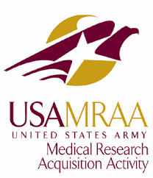
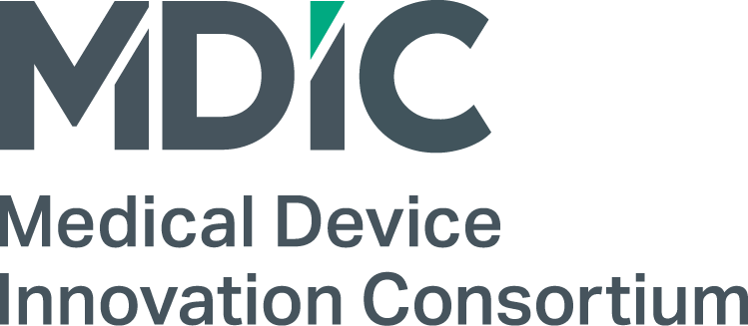
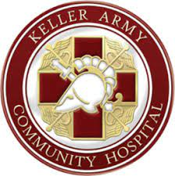
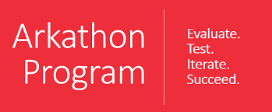
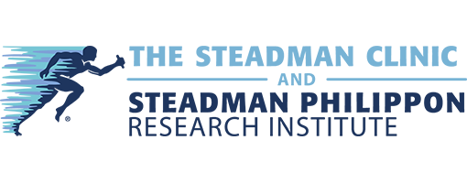
Movement-Synchronous Electrical Muscle Stimulation
For Accelerated Muscle Re-Strengthening & Re-Training
Category: Human Performance and Regenerative Medicine Contact: Josh Rabinowitz, CEO | josh@articulatelabs.com
Goal: Enable intelligent, remote musculoskeletal rehab assistance to occur seamlessly within a patient’s everyday activity
Company Overview
Novel Solution
Preliminary Data
Technology & Future Applications
Articulate Labs builds wearable medical devices that integrate physical medicine into everyday life by augmenting user activity with movement-synchronous electrical muscle stimulation. AL’s first medical device will aim to accelerate and improve knee rehabilitation
KneeStimTM, Articulate Labs’ first device, addresses unmet physical therapy needs by electrically stimulating weakened and inhibited quadriceps muscles in the course of everyday activity to enable faster, more convenient muscle strengthening activity.
Articulate Labs has conducted two studies to date with promising outcomes:
POC Study 1: Validating proof-of-concept for gait-synchronous electrical stimulation on 12 individuals with patellofemoral pain syndrome at University of Texas at Austin. Outcomes:
KneeStimTM device co-contracted vastus lateralis (VL) and vastus medialis (VM) on 99% of all measured swing phases
Device-initiated stimulation began on average at 37% of swing phase and terminated at 104%
Conclusion: single session ambulant, gait-synchronous NMES is feasible and can be useful for altering muscle activation patterns
POC Study 2: Measuring pain and function changes after four hours of use in 15 individuals admitted with knee conditions at the Clinique Romande de Readaptation
Outcomes:
Knee pain severity dropping by 1 point on KOOS-12 scale
Measurable trend toward positive improvement in gait length, gait speed, and reduced gait variability,
Informal feedback from patients of greater comfort and confidence walking while wearing KneeStim, especially while walking down stairs or slopes
KneeStim intelligently and autonomously adapts to movement through use of a proprietary joint modeling system, motion-tracking hardware, and algorithms to further tailor treatment. Instead of pre-defining very complex state definitions or specific activities, the NMES device identifies relevant vectored forces on the knee as indicated by the patient during perception of pain. The device stores and reacts to as many force combinations as required for the patient to address all future unanticipated movements that might precipitate pain and/or dysfunction.
The underlying system can be applied to other joints and other musculoskeletal conditions. AL’s long-term goal is to build out body-area networks of intelligent, communicating NMES devices to address complex musculoskeletal injures.
Unmet Needs in Civilian & Military Medical Sectors
Electrodes
Inertial Measurement Units
Real-Time Joint Modeling Operating System
Rechargeable LiPo Battery
Civilian Market – There are 15M in the U.S. symptomatic and seeking treatment for chronic knee conditions plus another 1M recovering from knee surgery, creating a $10B total addressable market, including $3B in avoidable healthcare expenditure. Of this population, <10% are prescribed physical therapy and <30% of those prescribed physical therapy attend all of their sessions or comply with home-based regimens.
Military Market – Non-combat physical training are responsible for 80% of musculoskeletal injuries (MSKIs), or 600 injuries per 1000 person-years, in the U.S. Army. 22% of those MSKIs to the knee, and servicemembers with previous knee MSKIs are 900% increased risk of reinjury. High demand for physical therapy and a preference to rehabilitate the most severely injured servicemembers often leads to incomplete knee rehabilitation.
In both sectors, incomplete rehabilitation that results from lack of time, reduced access to physical medicine, and/or lack of physical therapist availability leads to increased joint pain, dysfunction, and loss of mobility. Unmet need exists for effective, time- and cost-efficient options to extend physical therapy interventions beyond the clinic
Acknowledgements
Working KneeStim prototype at use at the Clinique Romande de Readaptation
Articulate Labs appreciates the support from and collaboration opportunities with the following entities:
Scientific Rationale
KneeStimTM builds on published research within physical medicine:
Quadriceps atrophy and inhibition correlate directly with knee joint pain and dysfunction stemming from the quadriceps’ diminished ability to manage weight distribution or shock absorption
Neuromuscular electrical stimulation (NMES) can be effective for overcoming pain-based muscle inhibition and to accelerate quadriceps strengthening
NMES combined with voluntary muscle activation leads to better strength gains than stimulation applied passively
Strengthening quadriceps muscle without regard to joint state (i.e. varus or valgus deformity) may exacerbate joint pain and dysfunction
Planned & Ongoing Studies
Articulate Labs has partnered with Keller Army Community Hospital at West Point and the Henry M. Jackson Foundation for Military Medicine on a 50-subject trial to measure changes in mobility and return to duty for Cadets recovering from ACL reconstruction. Support provided by MTEC. Recruitment begins Q3 2024.

